Slide 1
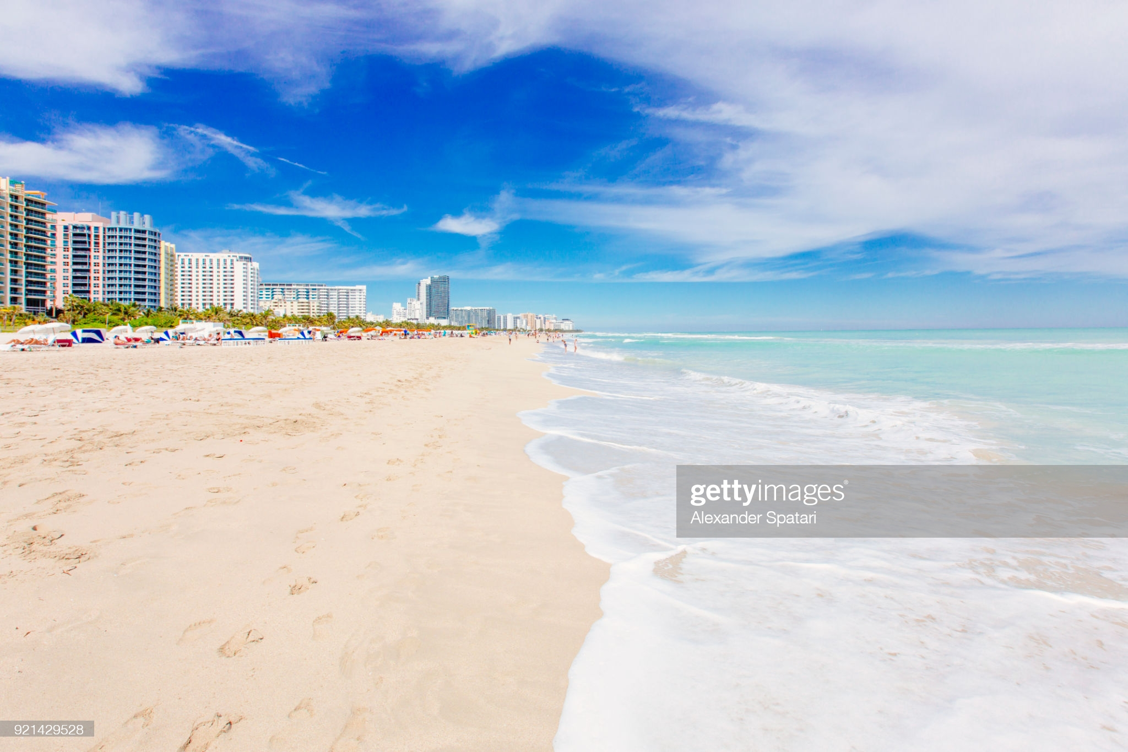
My Weekend in Miami
Rajat Thaker
Cody Thornton,
Brock Whitbread-Cole,
Tara Panzarino

Slide 2
Miami, Florida is one of the top travel destinations in the United States. As a domestic travel location, Miami is suitable for brief weekend getaways. Our application allows busy travelers to conveniently plan a short itinerary based on their budget and interests.

Slide 3
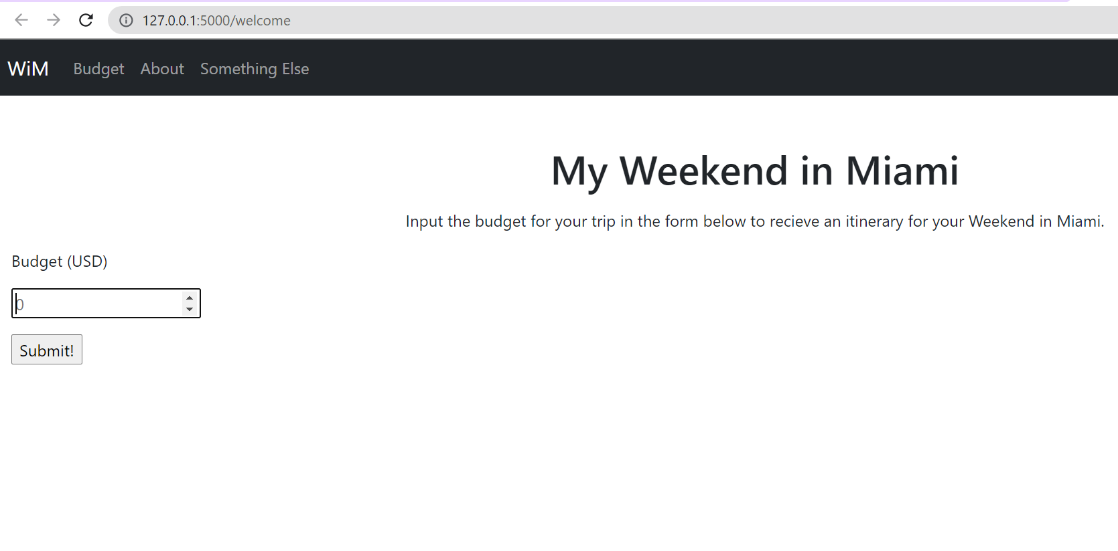

Slide 4
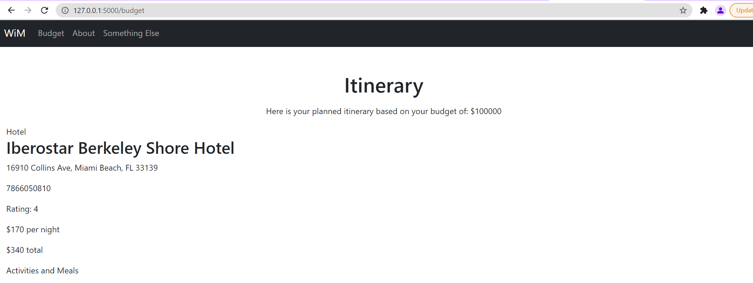

Slide 5
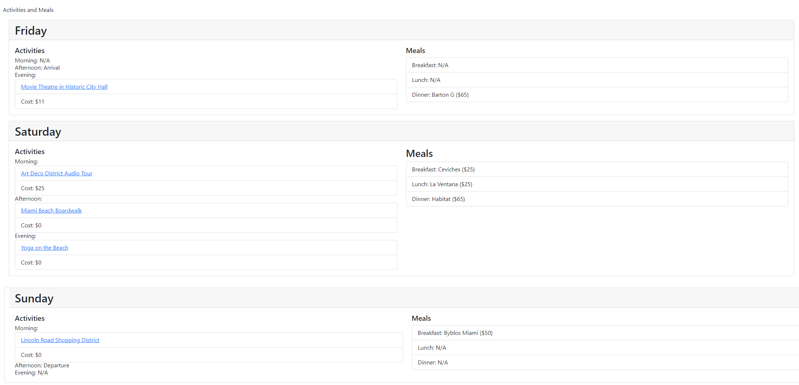

Slide 6
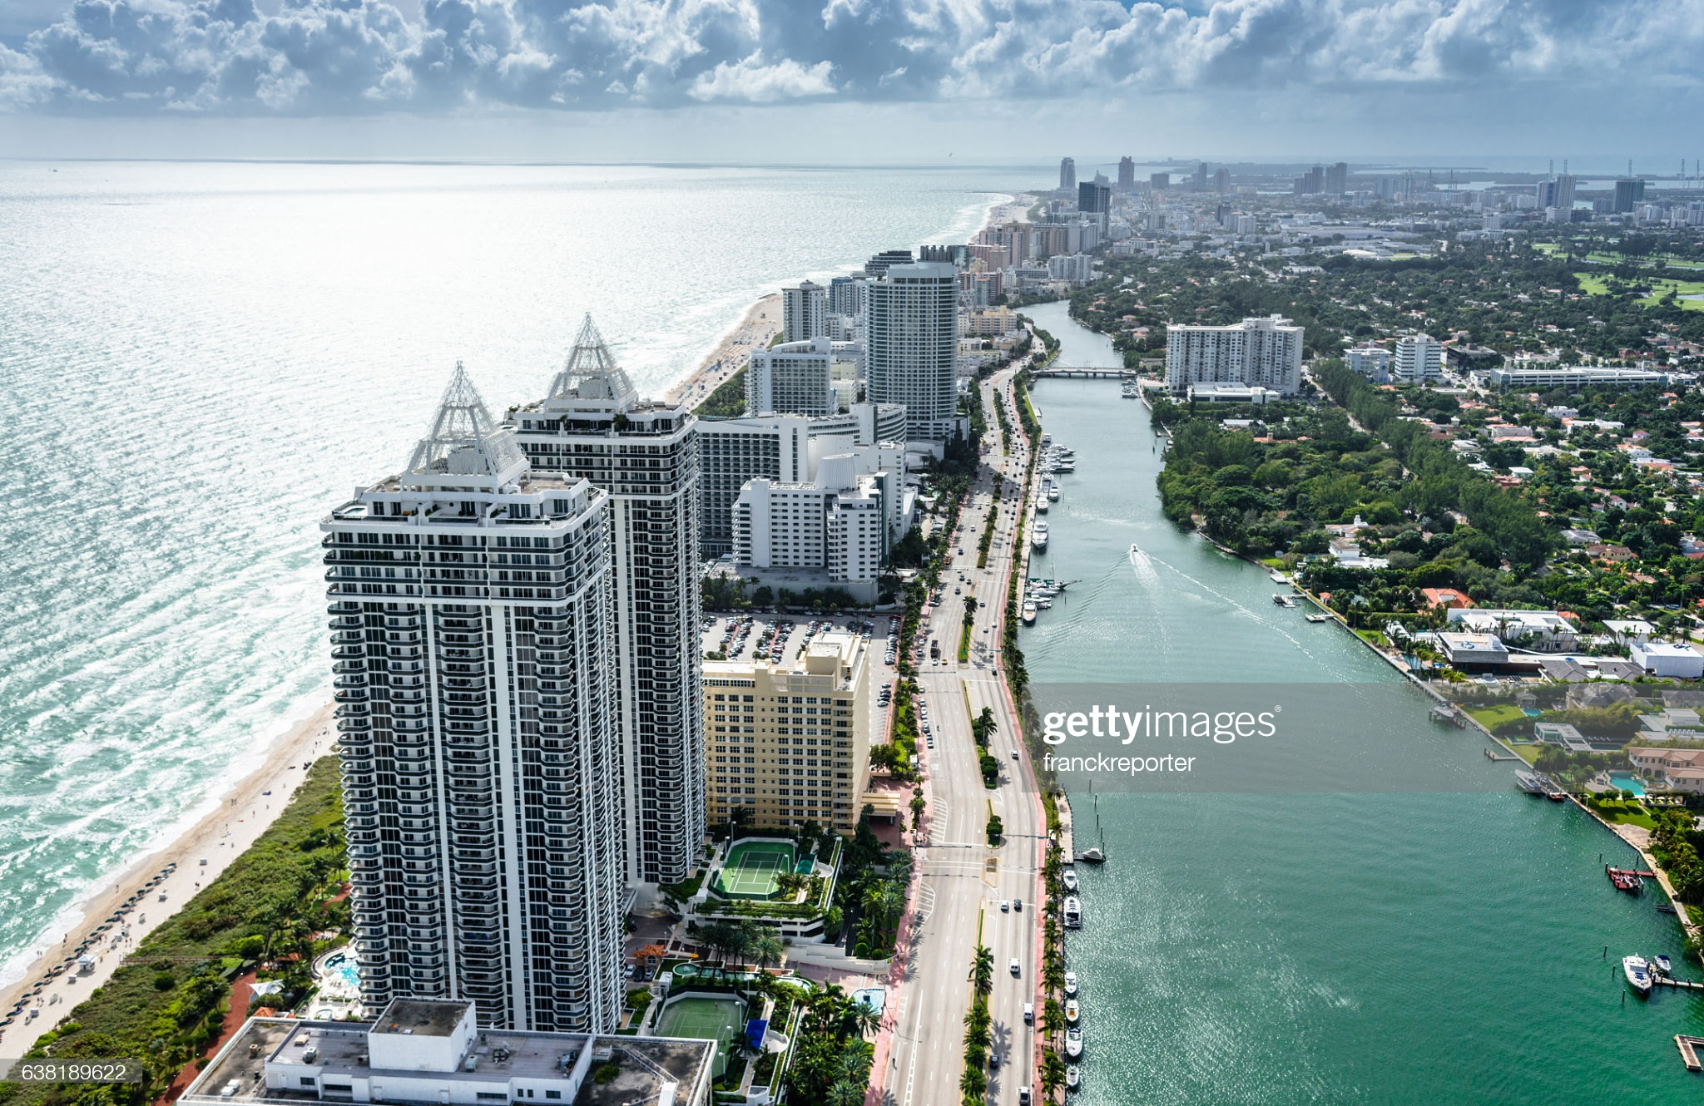

Tools

Slide 7
Github for Version Control and Project Tracking
Teammates make edits within own branch during earlier stages of project
Remain focused on separate goals
Merged separate branches into “staging” branch to test project deployment and make necessary edits
Team Evaluation: Excellent
Tara

Slide 8
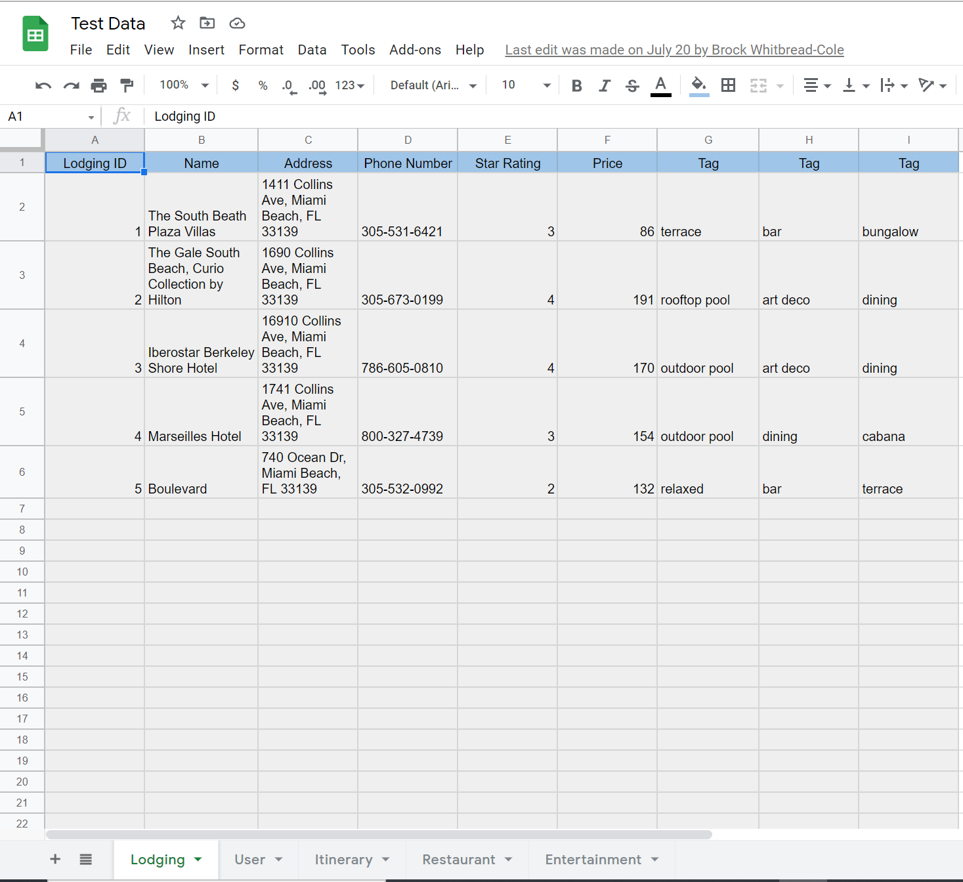
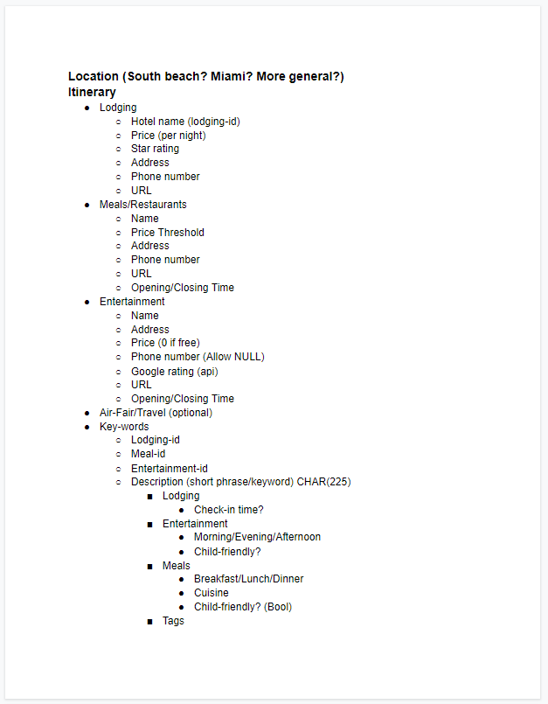
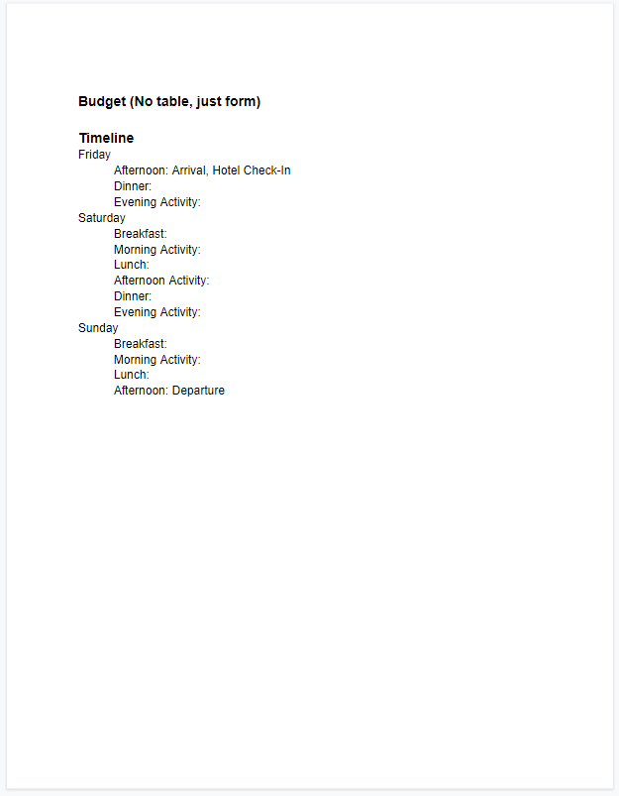
Google Drive for Project Tracking
Initial project schema
Single location to collect Restaurant, Hotel, and Entertainment raw data
Team evaluation: Good
Tara
Notes:
TARA END

Slide 9
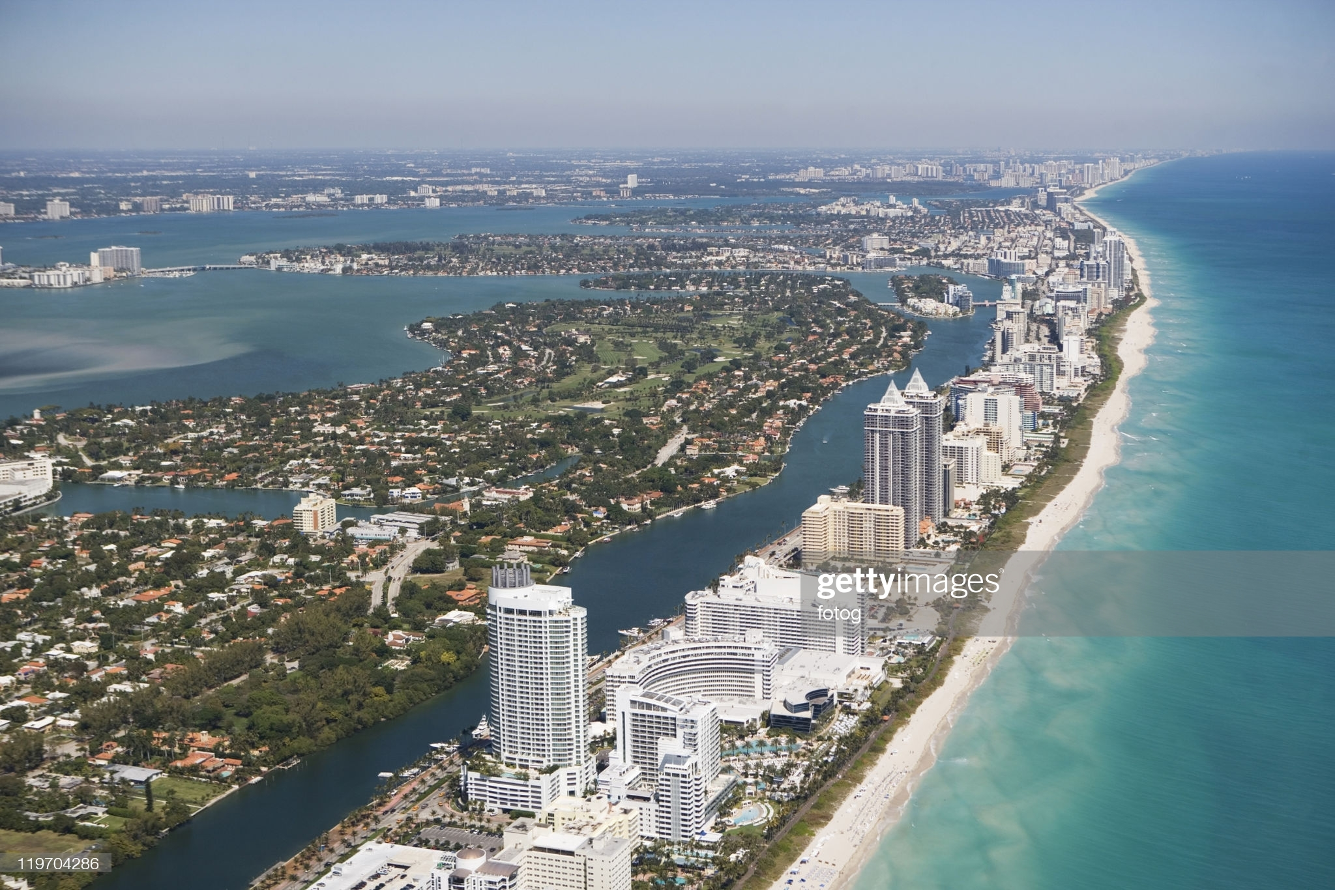
Sqlite3
Able to store database of Entertainment, Restaurant, and Hotel items
Ability to add more items to database in the future or utilize tags
Selections based on user specified attributes
cost, rating, etc.
Team Evaluation: Good
More complex syntax
Incompatible with Heroku deployment
Rajat

Slide 10
PostgreSQL with SQLAlchemy
Compatible with Heroku deployment
Evaluation: Good
Rajat

Slide 11

Unittest Unit Testing Framework
Consistent testing over hotel, restaurant, entertainment, and budget
Easy visibility of errors and exceptions
Team evaluation: Excellent

Slide 12
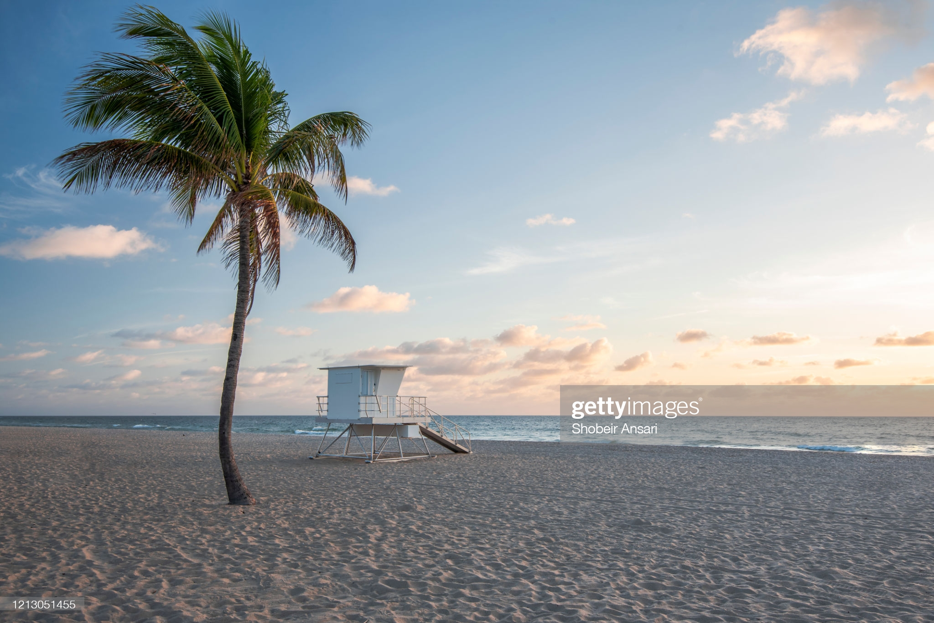
Programming Languages
Python
Backend
Hotel, Restaurant, Entertainment, Budget and Itinerary setup
HTML/CSS
Frontend
SQL
Database interaction
Team evaluation: Good
Cody

Slide 13
Flask Framework
Easy routing
Utilizes simple Python syntax
Ability to code in separate modules
Bootstrap Framework
Base template
Templates
Welcome, budget, itinerary, etc.
Team Evaluation: Excellent
Cody

Slide 14

Code Editors
Visual Studio Code
Atom
Vim
We “love” vim
Team Evaluation: Good

Slide 15
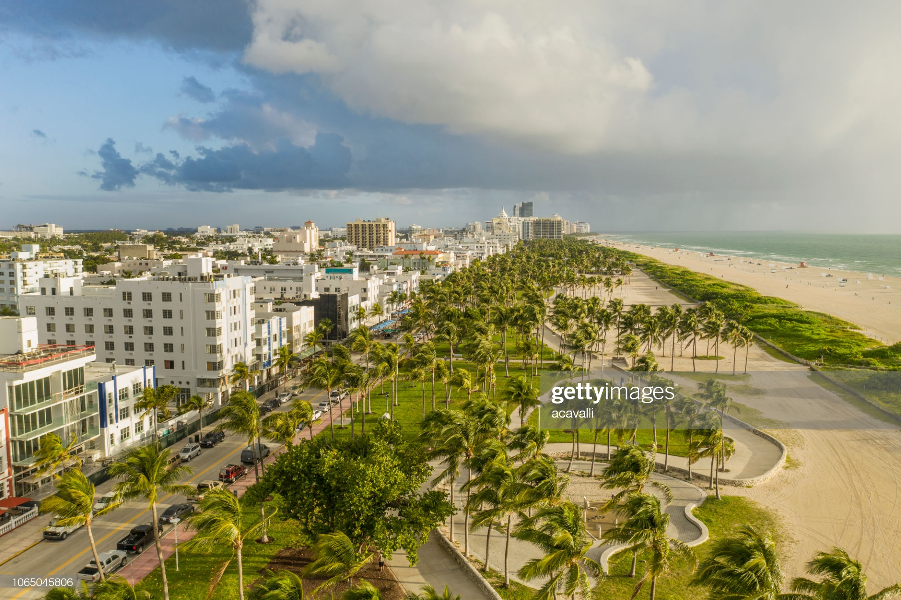
Heroku Deployment
Easy deployment
Incompatible with SQL
Team Evaluation: Good
Brock

Slide 16

Challenges
Remote Class
Scheduling
Team remained goal-focused
Excelled given time constraints and project scope
Utilized class topics
Thanks Cody ☺
Initial lack of experience for some team members:
HTML/CSS
Flask
Sqlite3
Unittest
Github
Heroku
PostgreSQL with SQLAlchemy

Slide 17
PROJECT DEMONSTRATION

